Slide 1
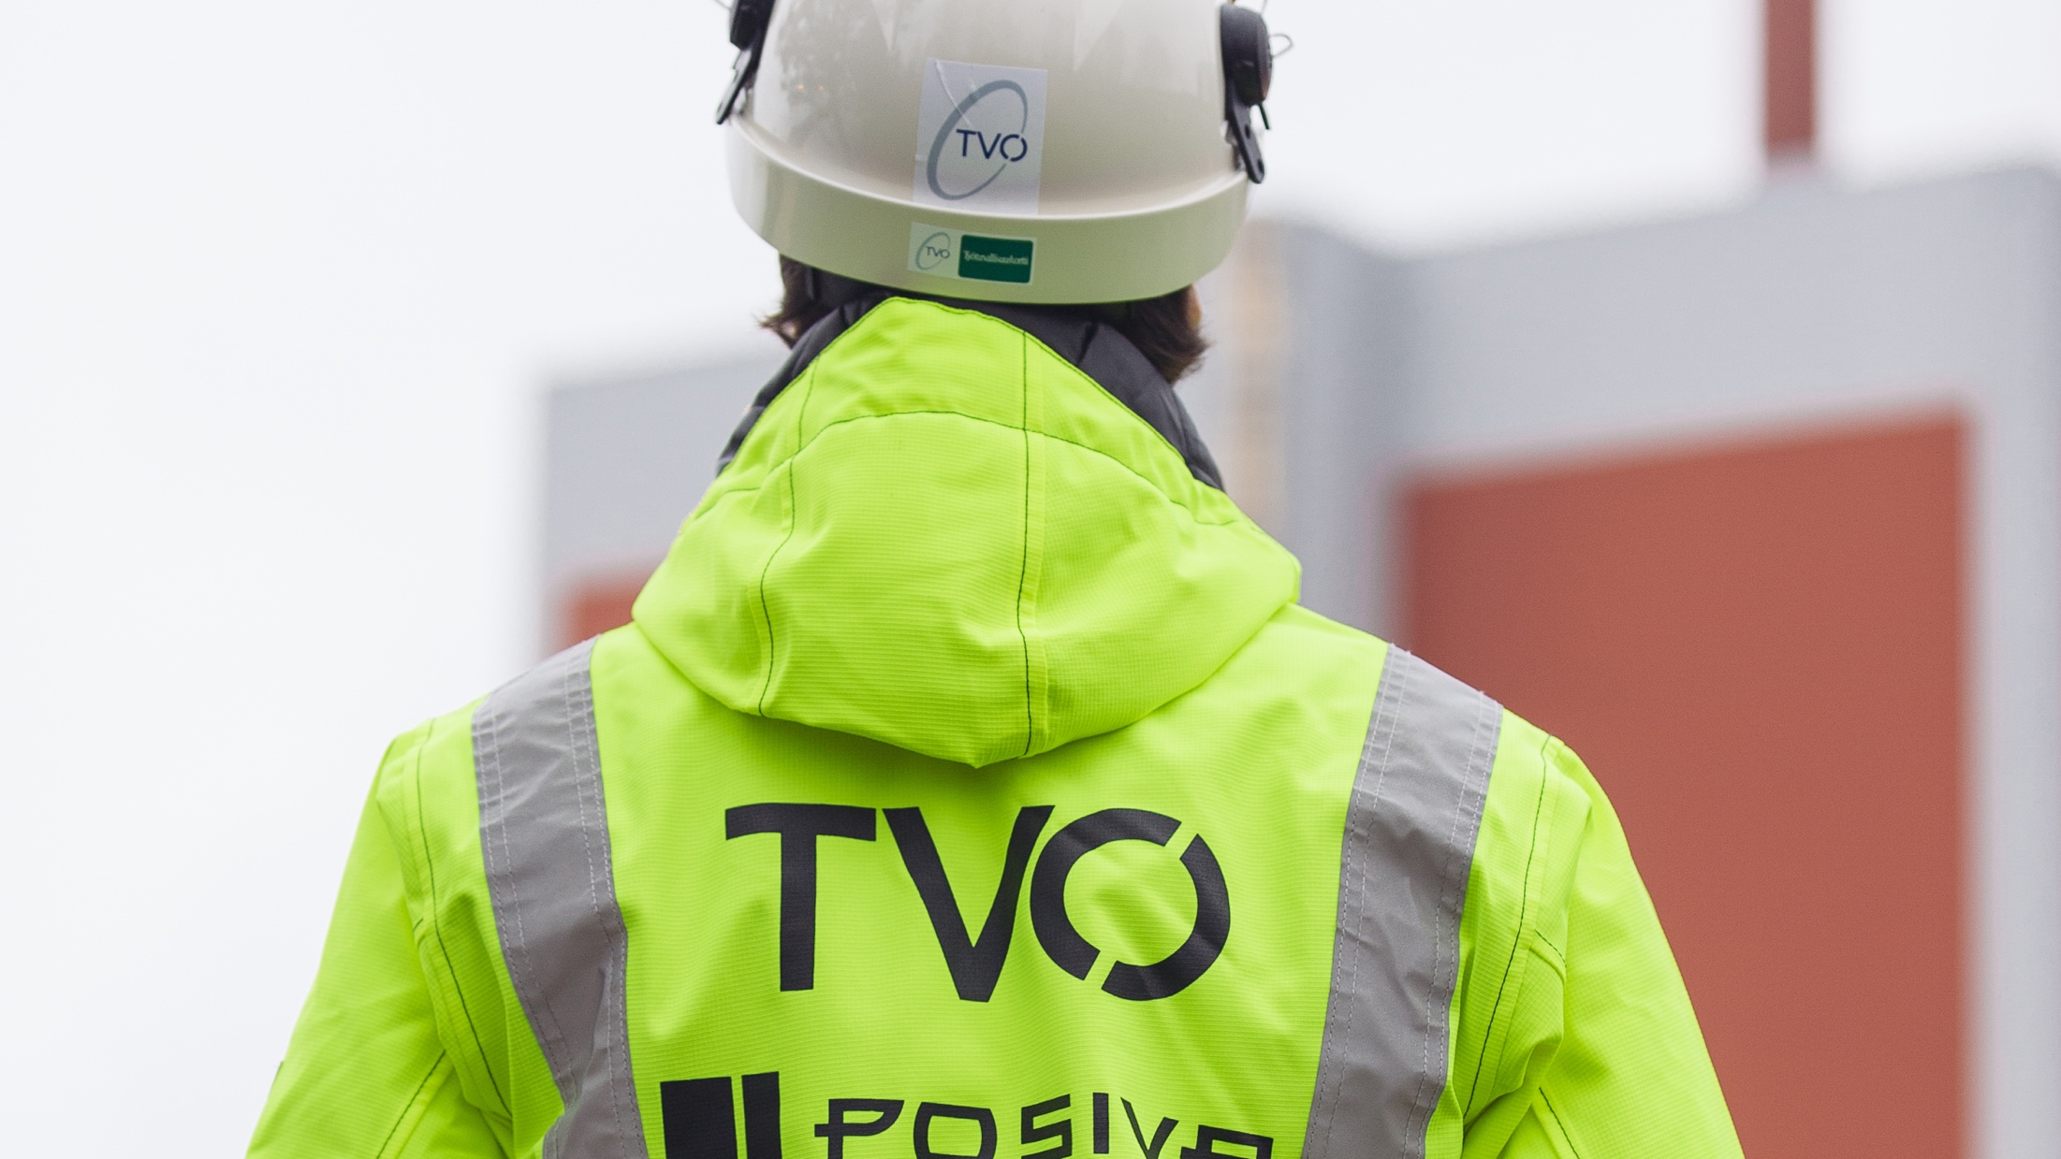
Case TVO

Slide 2
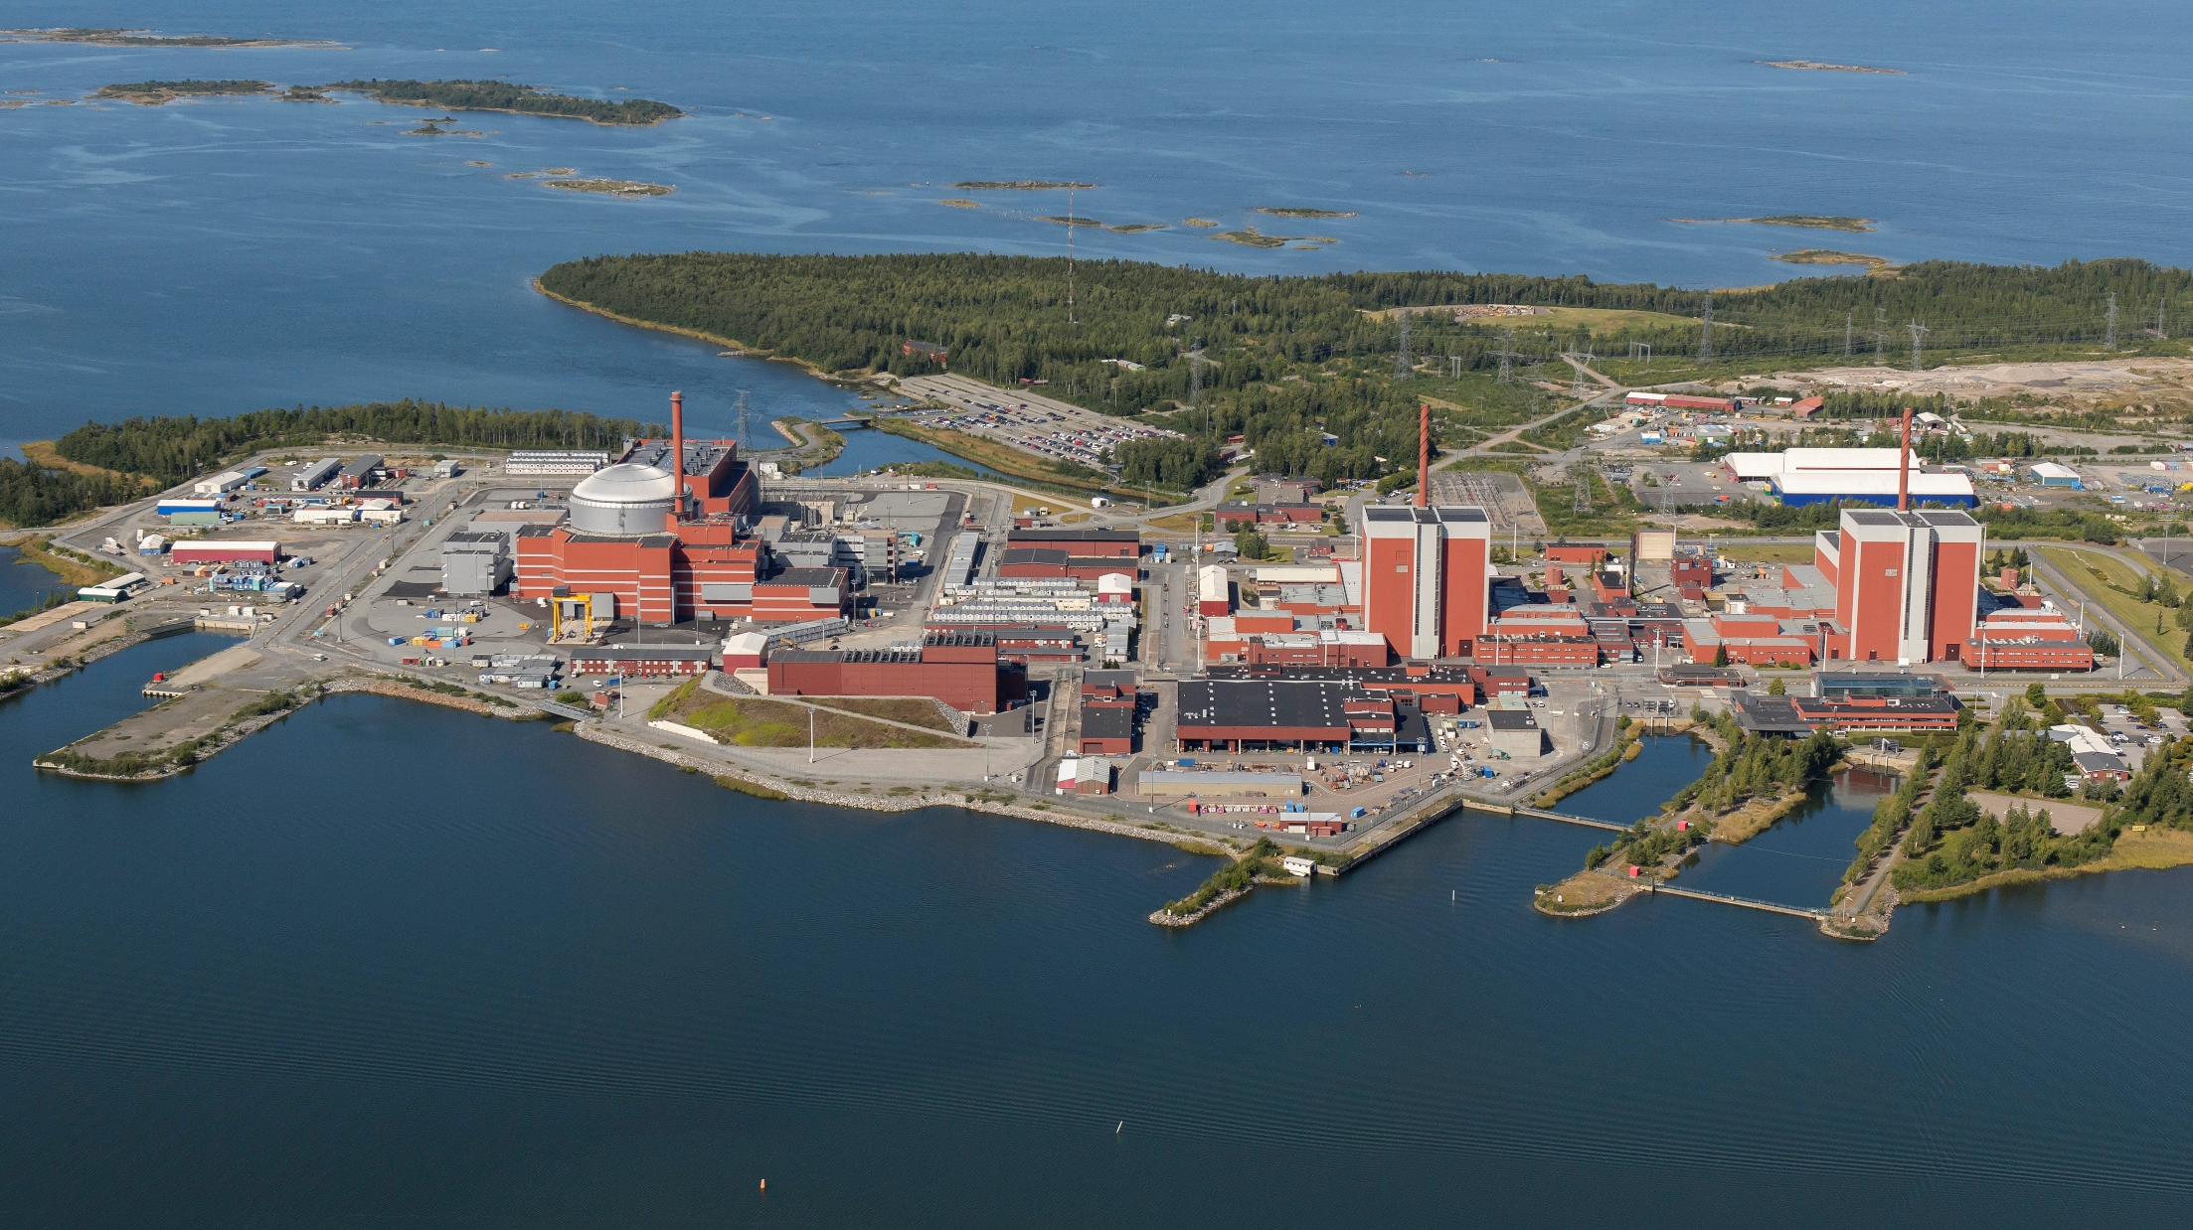

Slide 3
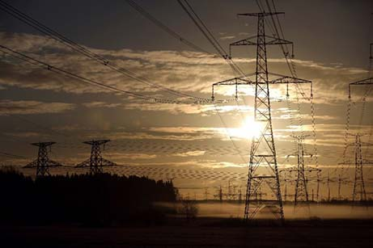
TVO – valued nuclear power operator
  40 years of reliable Finnish electricity production
  Annual production over 13 TWh, 21% of Finnish electricity production
  Now 16%, when OL3 is in production almost 30% of the electricity needed in Finland
  World leader in production reliability and in nuclear waste management

Slide 4

ELECTRICITY SUPPLY OF FINLAND 2019
    CONSUMPTION 86 TWh
      Half to industrial usage
      Another half to households and services
    PRODUCTION 66,0 TWh
      Renewables 47 %
      CO₂ neutral 82 %

Slide 5
Public attitude towards nuclear power
Source: TNS Gallup Oy 2019. Finnish Energy.

Slide 6
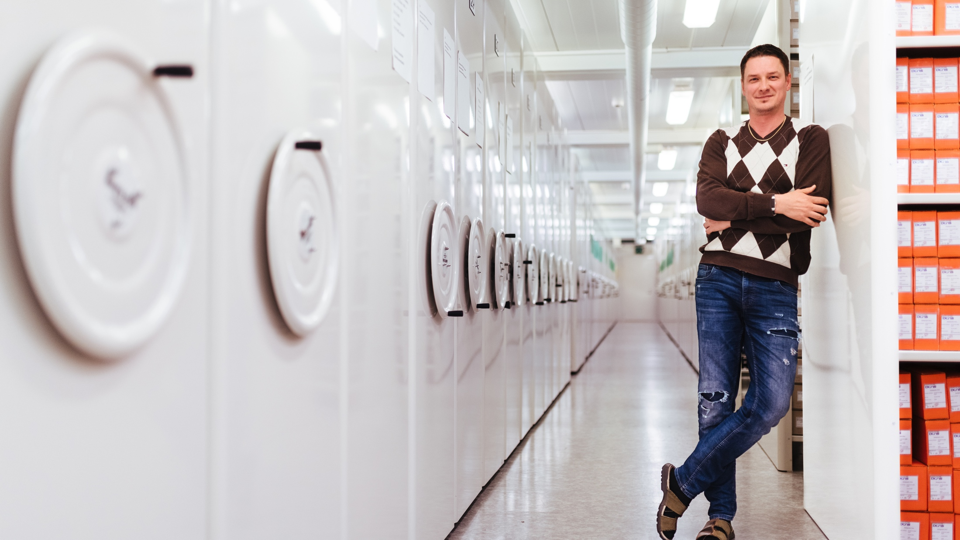
Staff complement (permanent) (person)
 | Y | K | N | R | S | T | TVO IN TOTAL
2019 | 1 | 492 | 3 | 122 | 75 | 229 | 922
2018 | 1 | 456 | 5 | 131 | 73 | 196 | 862
2017 | 1 | 396 | 6 | 123 | 70 | 187 | 783
 | CEÒ | Electricity production | OL3 project | Support services | Safety | Engineering | TVO in total
2019 | 1 | 492 | 3 | 122 | 75 | 229 | 922
2018 | 1 | 456 | 5 | 131 | 73 | 196 | 862
2017 | 1 | 396 | 6 | 123 | 70 | 187 | 783
Staff domiciles (%) (permanent) (person)
 | 2019 | 2018 | 2017 | 2016 | 2015
Eurajoki | 17 | 18 | 19 | 17 | 17
Rauma | 48 | 50 | 51 | 53 | 54
Pori | 17 | 15 | 14 | 14 | 13
Other | 18 | 17 | 16 | 16 | 16

Slide 7
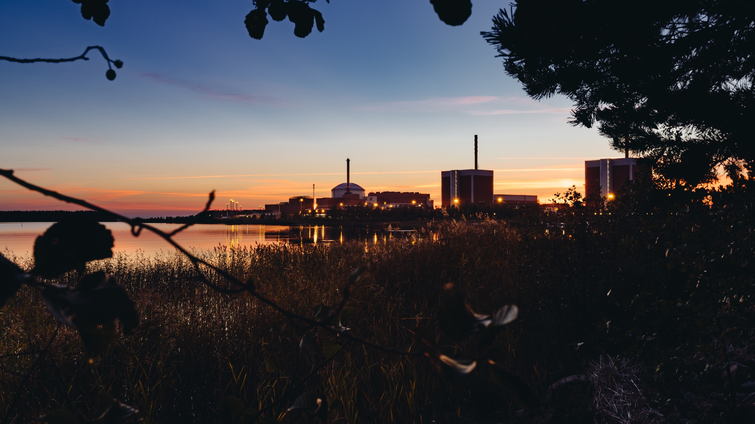
Sick leave rate (%)
 | Y | K | N | R | S | T | TVO IN TOTAL
2019 | 1 | 492 | 3 | 122 | 75 | 229 | 922
2018 | 1 | 456 | 5 | 131 | 73 | 196 | 862
2017 | 1 | 396 | 6 | 123 | 70 | 187 | 783
2.6
2019
3.1
2018
2.1
2017
2.4
2016
2.6
2015

Slide 8

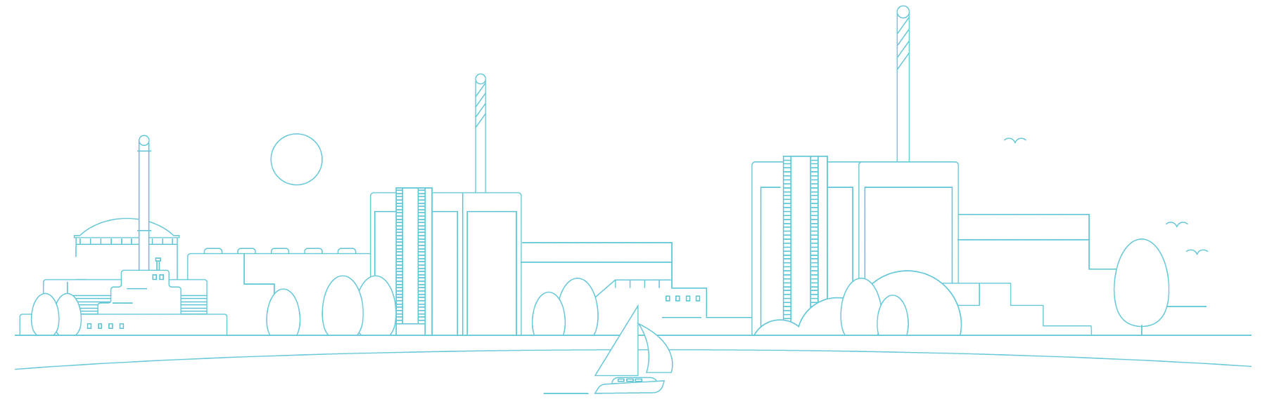
Average service time in years (permanent staff)
2019 | 2018 | 2017
10 | 11 | 12
10
2019
11
2018
12
2017

Slide 9
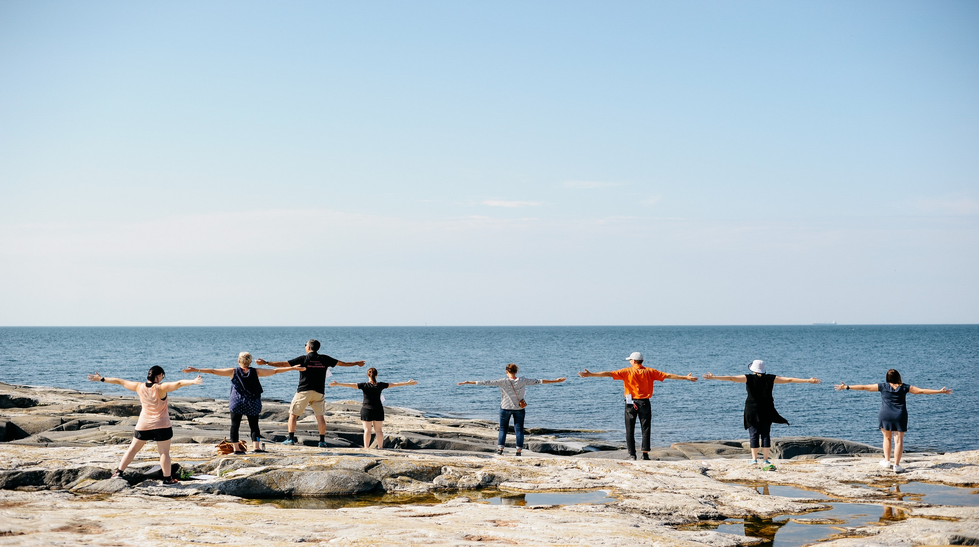
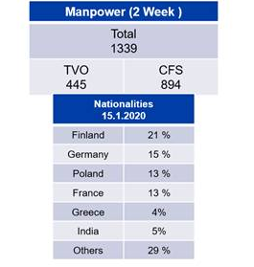
OL3 site 15.1.2020
200772 different nationalities, mainly from:
France
Germany
Finland
Creece
Poland
India
76 976 760 working hours at OL3 site:

Slide 10
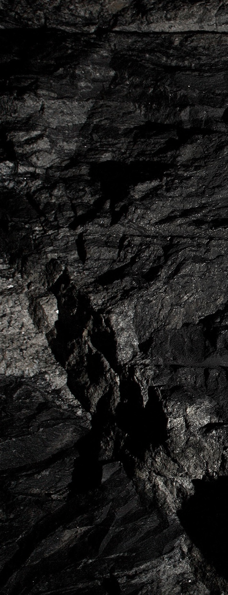
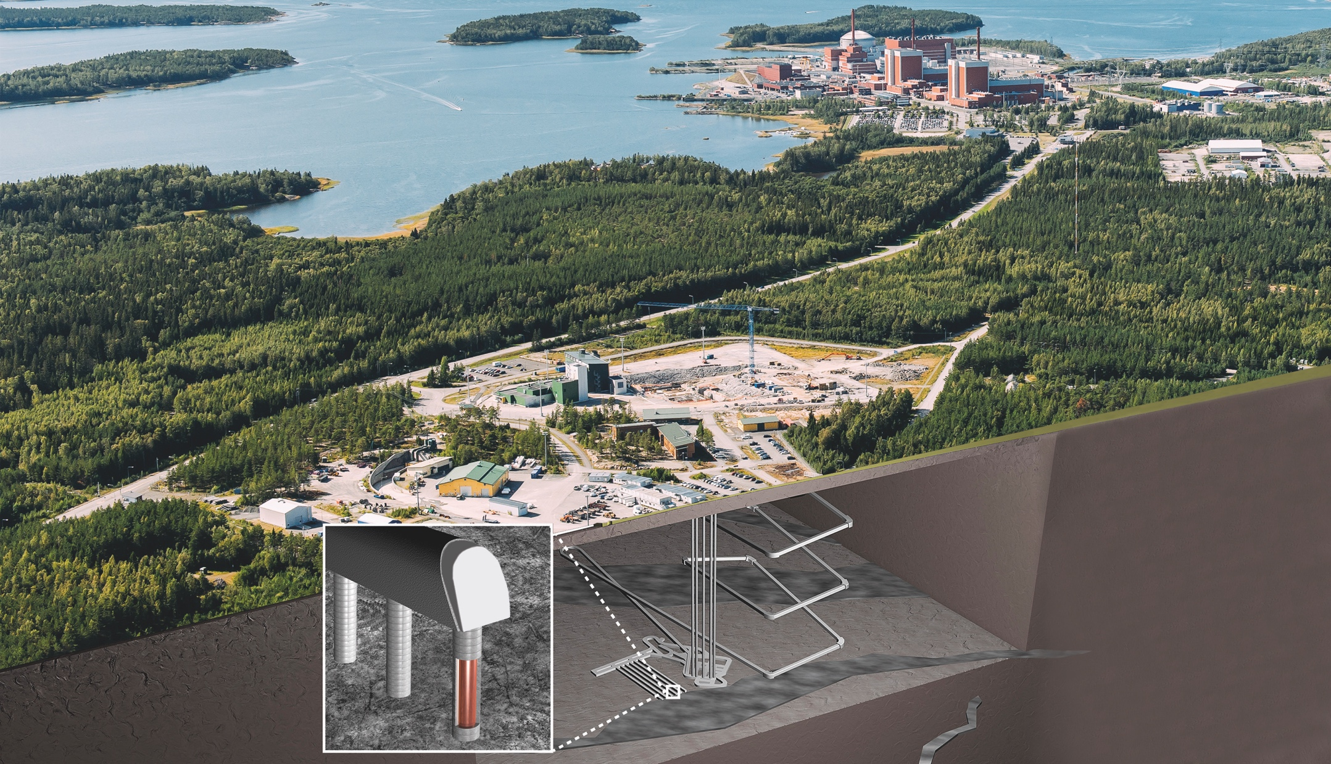

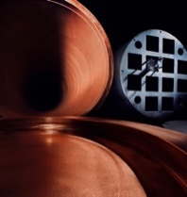
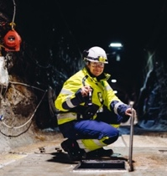
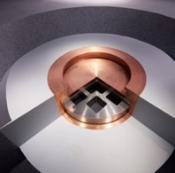
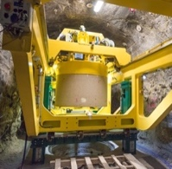
We have a solution
for final disposal
of spent fuel
We have a significant
role in climate change
as a part of the
sustainable
nuclear energy
#wehaveasolution
Site investigations
Development of the machinery
Development of the engineered barriers

Slide 11
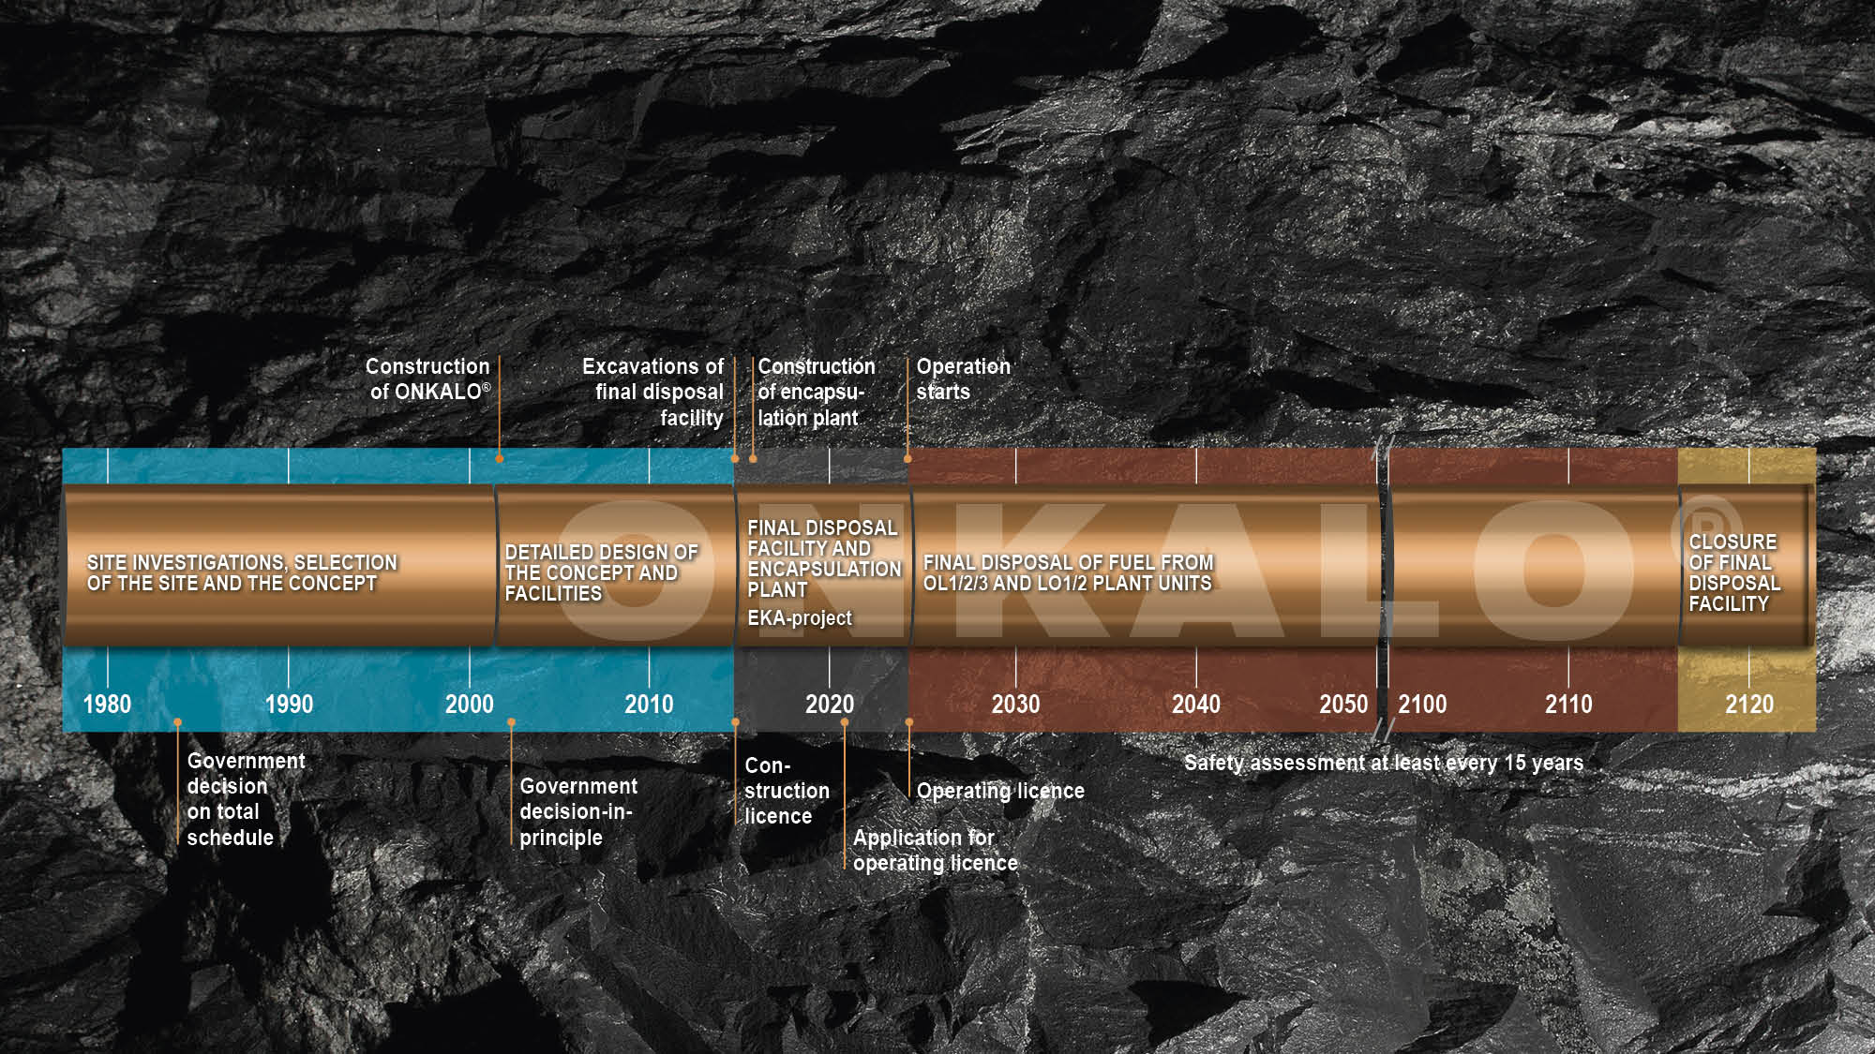
Posiva is the first to start
the safe final disposal in ONKALO ®

Slide 12
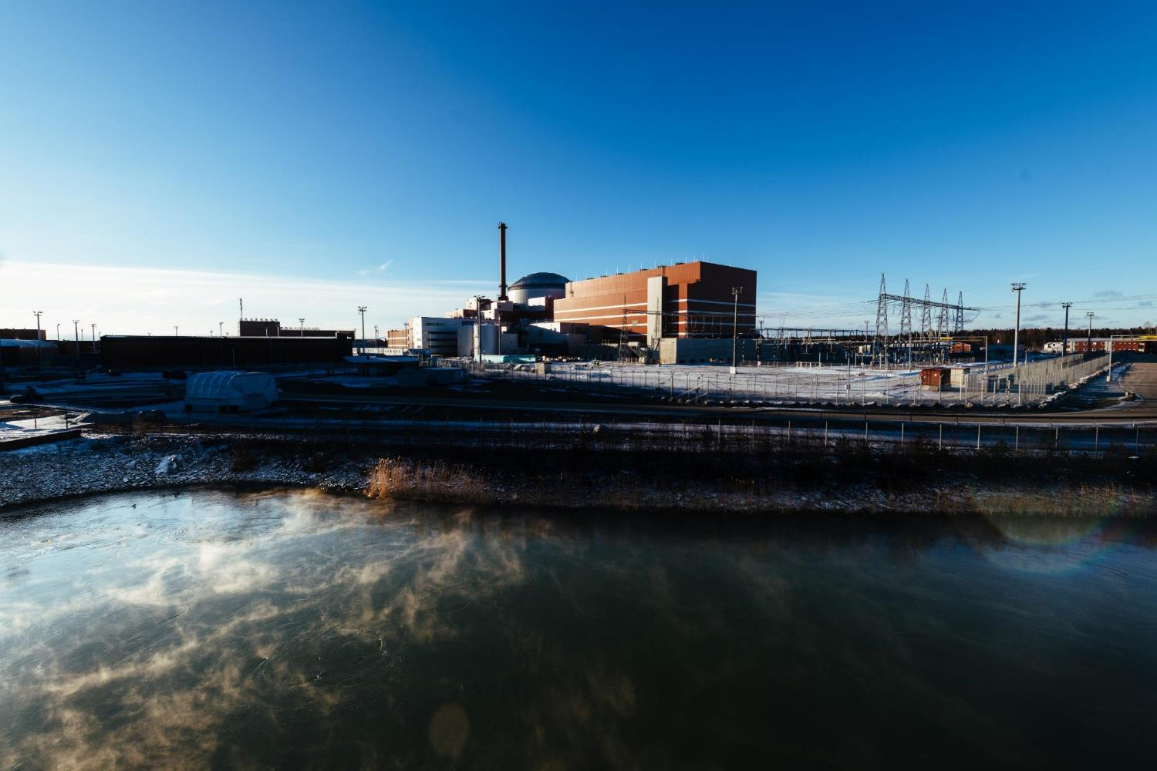

#FinlandsGreatestClimateAct

